Slide 1
Marvel Comic Collector
Ken Thompson
David Goodrich
Khadija Almaskeen

Slide 2
Overall application’s concept
A Marvel Comic collector’s resource site, providing latest comics for their favorite Marvel characters. It also provides purchase options for ebay and bookstores.
Motivation for development
Leveraging Marvel’s powerful api allows fans to search and keep up to date on the most recent comics released.
Design process
Brainstormed based on Marvel API options.
Picked comics and characters API’s as our main focus
Divided work into
Front end
Backend
API

Slide 3
Future development
User login/authentication
Save fav chars and comics
Default map to current location
More detailed map search
Add other comic API’s
Expand ebay display options
Technologies used
Marvel API
Ebay API
Google Places API
Materialize
Moment.js
Firebase
Google Fonts
Jquery
Javascript
CSS
HTML
ajax
MD5 hashtag script

Slide 4
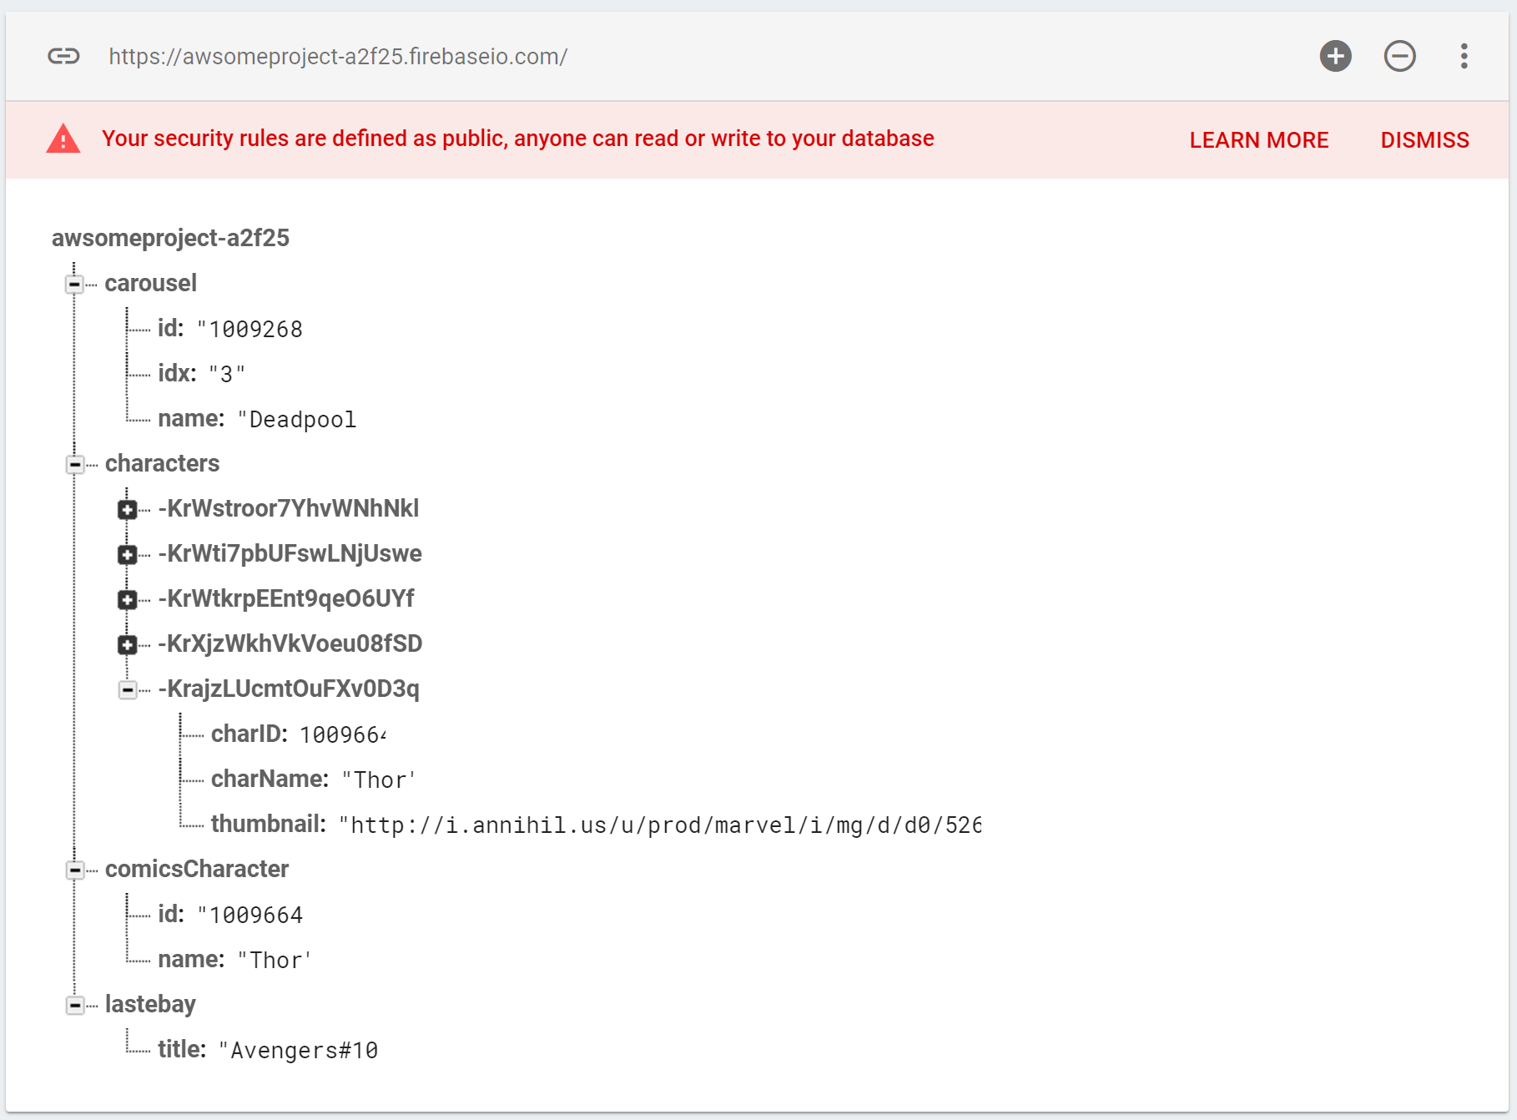
Firebase
Persistence
Last character looked up on carousel
Characters searched 8
Last character’s comic looked up
Last eBay searched

